Slide 1
Developing safeguarding measures
NOM PPT 5.13
UNESCO
Intangible Cultural Heritage Section

Slide 2
In this presentation...
What are safeguarding measures?
Examples of safeguarding measures
Developing safeguarding measures

Slide 3
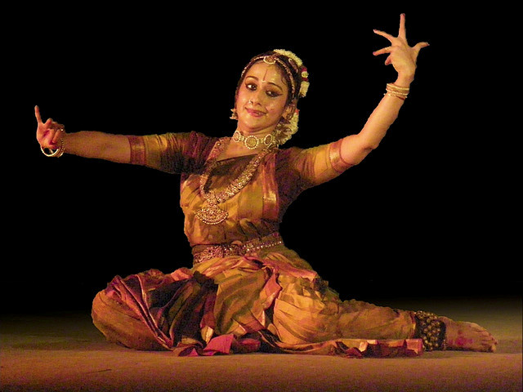
Safeguarding concepts
Safeguarding is ensuring the viability of ICH
Safeguarding measures address threats and risks to viability.
Notes:
http://www.flickr.com/photos/34056112@N00/2289578246/
Uma Muralikrishna performing Kuchipudi at Yamini 2008 at IIM Bangalore. By Vasanthakumar

Slide 4
Safeguarding measures
Identification
Inventorying
Documentation
Research
Revitalization
Ensuring sustainability
Ensuring access to places and materials
Transmission through education
Transmission
Enactment
Communities
Groups
Awareness-raising
Other agencies

Slide 5
Kinds of safeguarding measures
Identifying and defining the ICH
Supporting continued enactment and transmission
Creating an enabling legal and administrative environment
Raising awareness about the value of ICH
While balancing risks and benefits for each activity

Slide 6
The Voladores ceremony (Mexico)
© 2008, by Cumbre Tajin

Slide 7
Threats to viability - 1
The flight of the Voladores around the pole is the climax of the ceremony.
Increasingly only this part of the ceremony is performed, for tourists, outside the community context
© 2008, by Cumbre Tajin

Slide 8
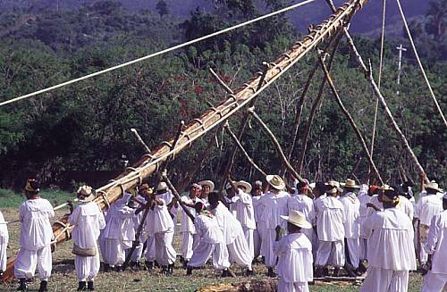
Threats to viability - 2
Poles for the ceremony were traditionally cut down in the forest and ritually prepared.
Too few appropriate trees, now using fixed metal poles
© 2008, by Cumbre Tajin

Slide 9
Threats to viability - 3
Ritual preparations for the ceremony maintain its significance for the community.
Performance by professional dancers reduces focus on ritual aspects.
© 2008, by Cumbre Tajin

Slide 10
Voladores safeguarding measures
Meetings with Voladores groups; State and NGO support
Measures include:
Reforestation
Opportunities for performing the entire ceremony including ritual dimensions
Schools for Volador Children promoting transmission of knowledge & skills including ritual dimensions

Slide 11
Developing safeguarding measures
Ensure community participation
Assess viability, threats and risks
Assess commitments, opportunities, available funds
Identify other partners
Study previous interventions
Determine safeguarding measures, their order and relative importance
Monitoring and evaluation

